Slide 1
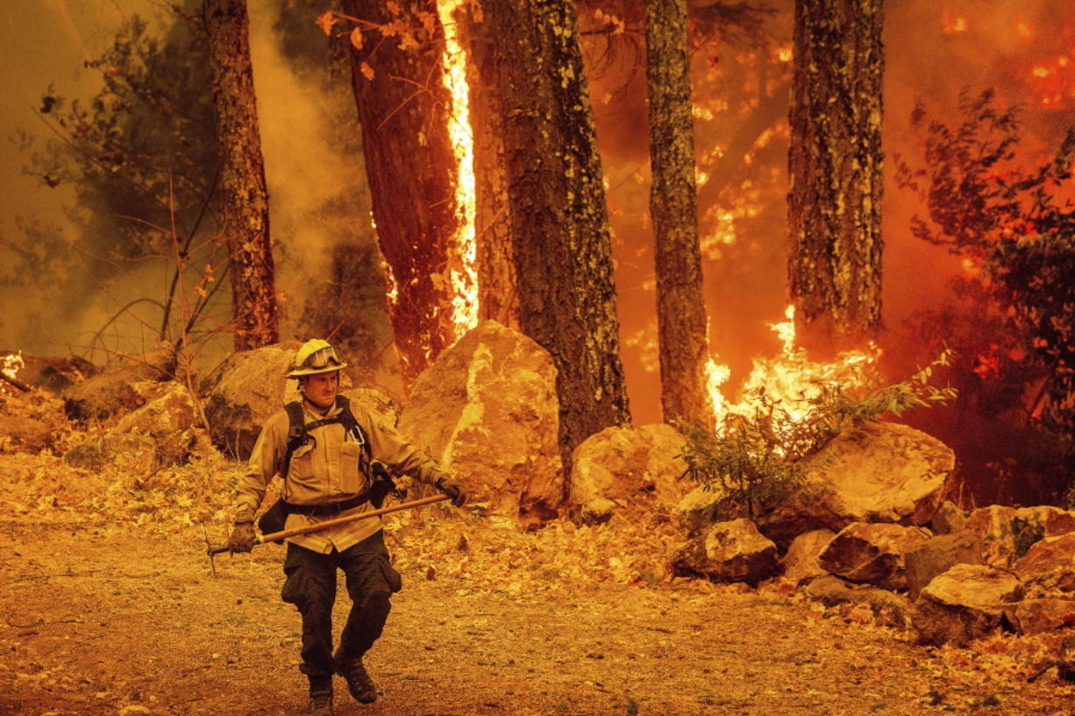
Analyzing Forest Fires
The Warriors
Members:
Rafael Brennand
Trevor Haney
Brenda Mitchell
Travis Molnoskey

Slide 2
Agenda
Summary: Rafael
Data Gathering: Trevor/Travis
Data Visualization: Rafael
Results: Travis

Slide 3
Summary
Our group sought to analyze the impact and frequency of forest fires in California to see if any correlative factors could be determined and the strength of their influence on the severity of fires.
Largest correlative factors in occurrences and severity?
Highest causes of wildfires?
Most affected areas?
These insights can give us a better understanding of how and why fires start and how bad they might be depending on contributing factors.
While we were able to answer the questions we had to some extent, we did not answer them to the level of detail we wanted.

Slide 4
Data Gathering: The search for less data
Source: Kaggle
Two sources, one source had almost a gigabyte of data but stored in SQLite format
Source: National Oceanic and Atmospheric Administration (NOAA)
Restricted timeframe from 2005 – 2015
Data parameters: Comparing number of fires and acres burned with temperature max, wind speed, latitude, precipitation, season, and cause
Notes:
Talk about the massive amount of data we found so we had to restrict the data we used
NOAA ties in networks of weather information: https://www.ncdc.noaa.gov/cdo-web/results
NOAA API uses a token in place of an API key

Slide 5
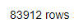
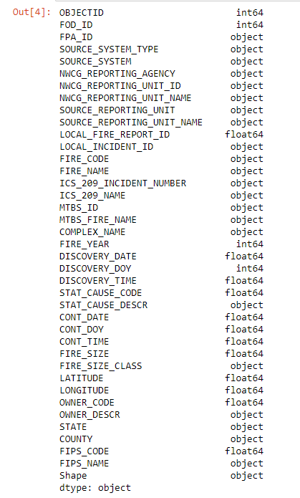
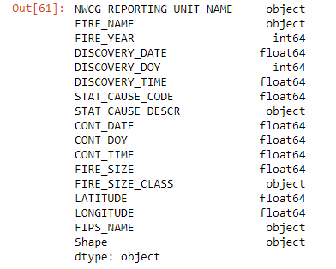

Data Formulating: Cleaning and subsetting data
Notes:
We reduced the time frame of our Kaggle dataset originally at 1993-2015 to only 2005-2015 to help shrink the dataset, as well as restricting data to only fires located in California.

Slide 6
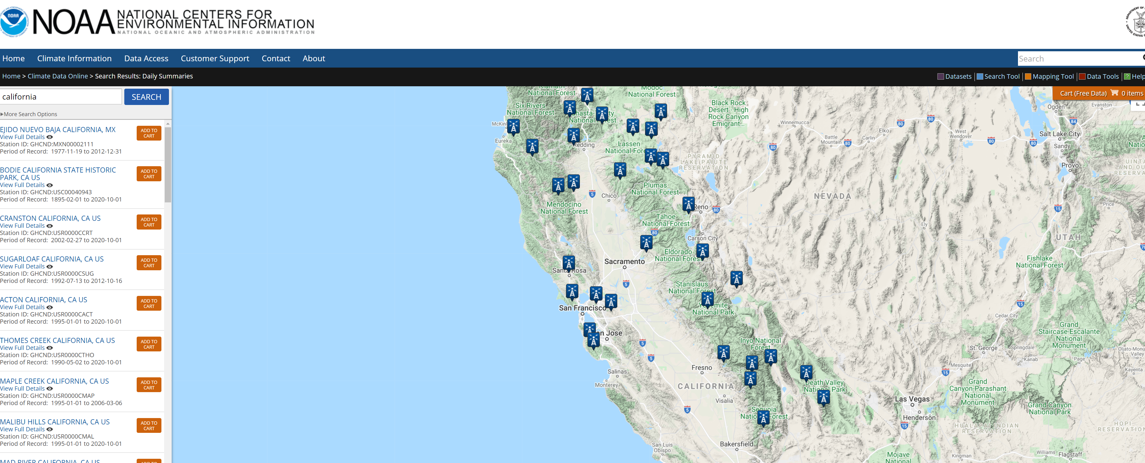
Data Gathering: The search for less data

Slide 7
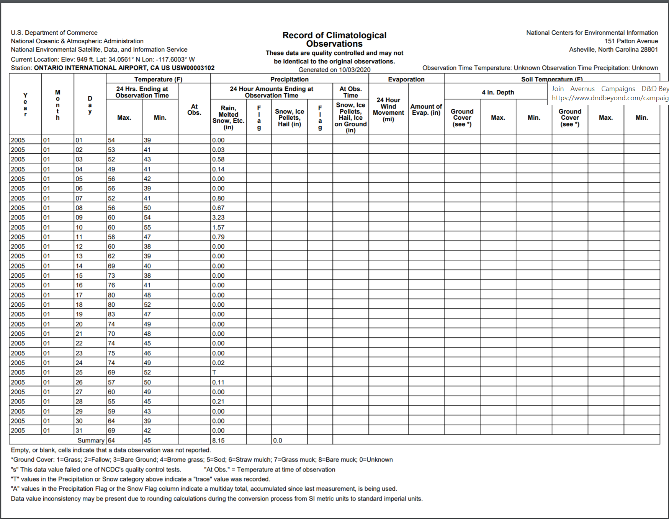
Data Gathering: The search for less data

Slide 8
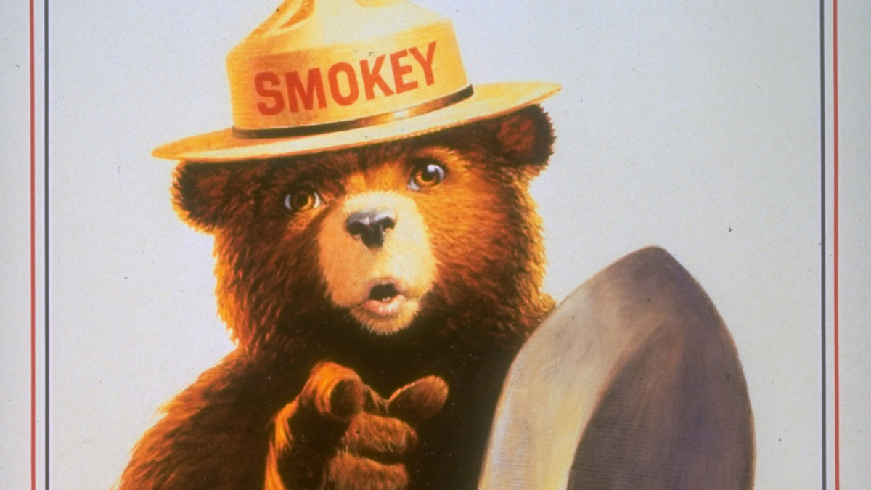
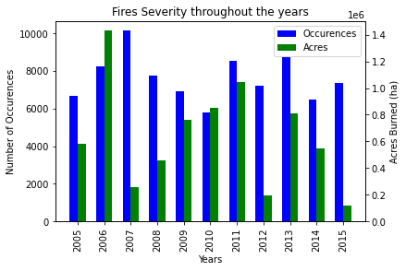
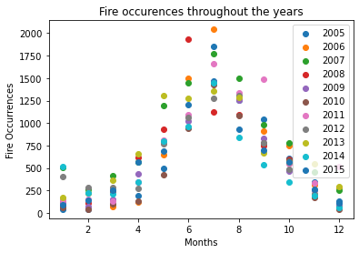
Data Visualization: Fires within our time period
Notes:
From the image on the right we can see that seasonality has a high influence on the fire occurrences across all years in our date range. Interestingly, on the left image we see in years 2007 to 2010 that when severity of fires is down, the occurrences are actually up. This surprised the team and we wanted to do more analysis on but didn’t have the time.

Slide 9
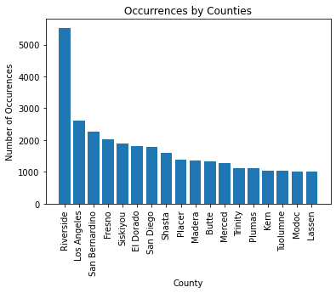
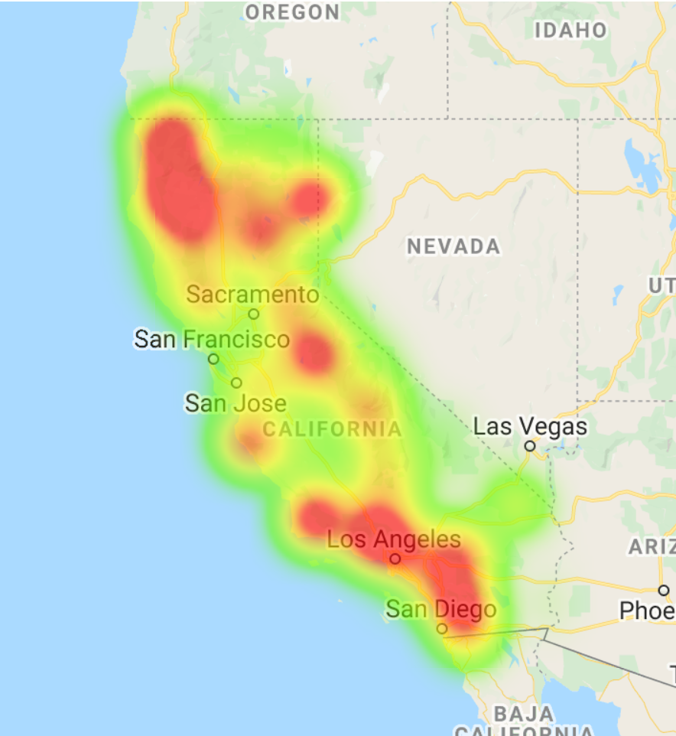
Data Visualization: Occurrences by counties
Heatmap based on severity (acres burned)
Notes:
From these images we can see that while in northern California the number of occurrences are generally in forested areas away from population centers, in southern California the fires are concentrated more heavily where there is a large population. But more generally, there are less fire occurrences in non-forested areas.

Slide 10
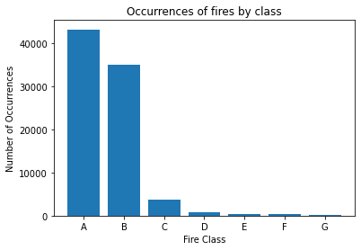
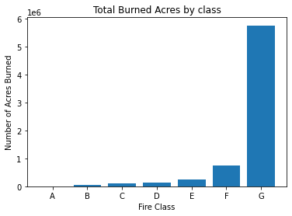
Data Visualization: Occurrences by Size
Notes:
From these images we can see that while in northern California the number of occurrences are generally in forested areas away from population centers, in southern California the fires are concentrated more heavily where there is a large population. But more generally, there are less fire occurrences in non-forested areas.

Slide 11
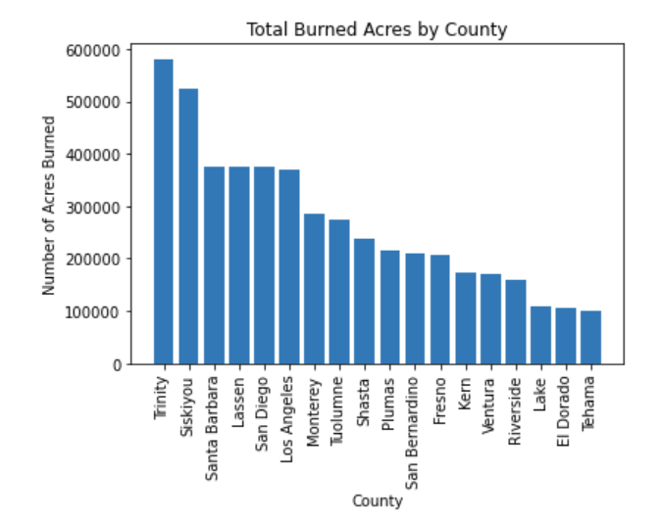
Data Visualization: Severity by counties

Slide 12
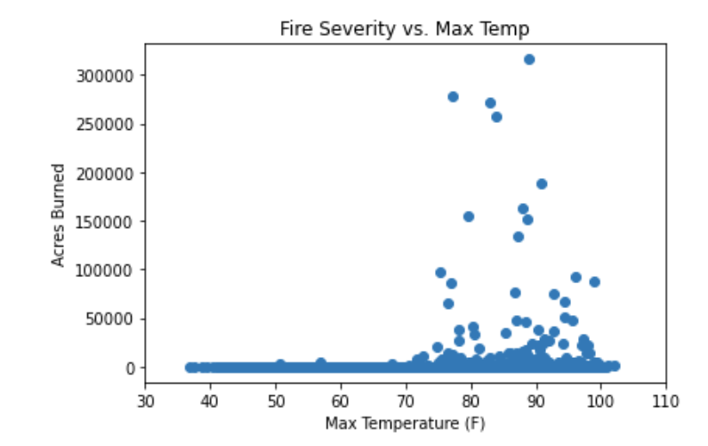
Data Visualization: Severity by Temperature
Notes:
This graphs helps us determine that while there may not be a strong correlation between all fires and temperature, very large fires are only common at temperatures higher than 73F.

Slide 13
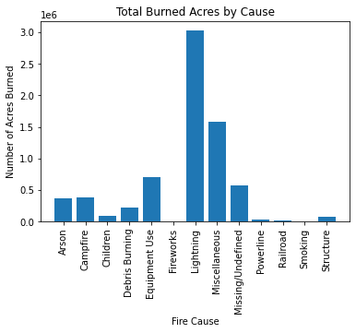
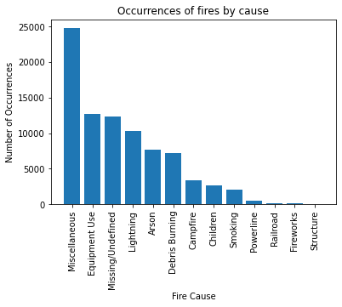
Data Visualization: Severity by Cause
Notes:
We see from these two plots that lightning and “miscellaneous” are the leading causes of large fires in California. Our assumption is this is because lightning strikes are reported far later to authorities than any manmade cause of a fire, therefore giving the fire longer to burn and grow.

Slide 14
Results: The Factors of Fire Severity
Severe Factors:
Cause: Lightning
Temperatures > 75F
Northern California region (low population density)
Available fuel (forested lands)
Non-Factors:
Latitude
Notes:
We found through our analysis that the most severe fires are characterized by being ignited by lightning, as well as a temperature average above 75 around the time they started and occurring most frequently in the northern California counties of Trinity and Siskiyou. Both of these counties are characterized by large land areas and low populations in heavily forested lands.
Latitude seemed to have little effect on the occurrence or severity of fires, being seemingly evenly spread between the northern and southern latitudes.

Slide 15
Difficulties: Analysis Paralysis
Where to start
Too much data, too little time
API documentation, token based API
Graphs galore
Scope limitations
Additional work:
Resource focus (firefighters)
Precipitation
Wind/direction
Location vs extinguish times
Notes:
Our largest challenge with this project was choosing where to start.
The datasets we found were very robust and much of the data had to be scrubbed of information that was useless to us. The NOAA API documentation also proved cumbersome to navigate, and slow to run when fetching historical weather data, with some for loops taking around 30 minutes per run. The NOAA data also used a token instead of the traditional API key included in the query url.
Picking and choosing which graphs and results to focus on and include in such a limited discussion time was also needed to avoid an overflow of information. We had to scale back our original scope significantly and could foreseeably work on this project for weeks to come to extract everything we had originally planned.
Correlations between resource focus, precipitation, wind direction, location and fire extinguish time were all things we would like to explore more, given more time.

Slide 16
Questions??

